Slide 1
Chapter 3.2 High-Quality Variables
CCSW 325 (Software Construction)
Notes:
Last Update: 22/8/2019
Version 1.0

Slide 2
Outline
Scope
Using Each Variable for Exactly One Purpose

Slide 3
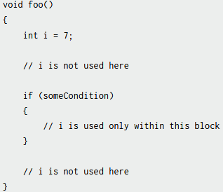
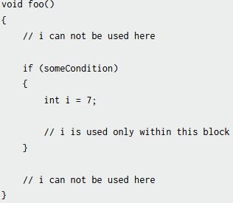
Scope
Scope, or visibility, refers to the extent to which your variables are known and can be referenced throughout a program.
A variable with large scope is known in many places in a program
A variable with limited or small scope is known in only a small area of a program

Slide 4
Scope
Different languages handle scope in different ways.
In some primitive languages, all variables are global. You therefore don’t have any control over the scope of a variable, and that can create a lot of problems.
In C++ and similar languages, a variable can be visible to a block (a section of code enclosed in curly brackets), a routine, a class, or the whole program.
In Java and C#, a variable can also be visible to a package or namespace (a collection of classes).

Slide 5
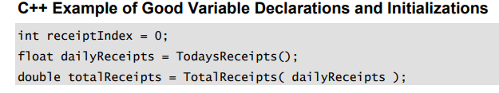
General Guidelines for Minimizing Scope
Initialize variables used in a loop immediately before the loop than back at the beginning of the routine containing the loop
Don’t assign a value to a variable until just before the value is used

Slide 6
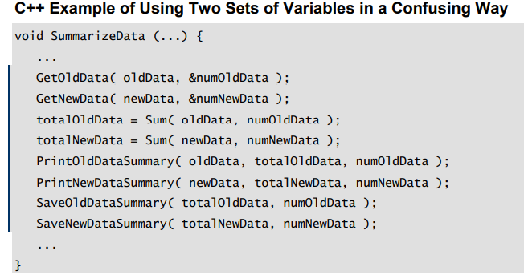
General Guidelines for Minimizing Scope
Group related statements
oldData, newData, numOldData, numNewData, totalOldData, and totalNewData all at once—six variables for just this short fragment.

Slide 7
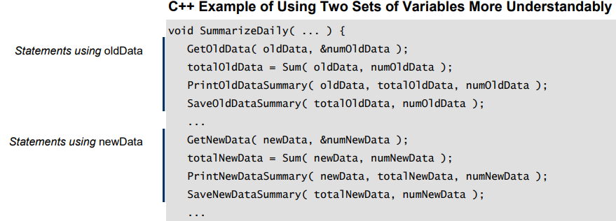
General Guidelines for Minimizing Scope
two blocks are each shorter than the original block and individually contain fewer variables
Good or bad? Good: more understandable, with groups

Slide 8
General Guidelines for Minimizing Scope
Begin with most restricted visibility, and expand the variable’s scope only if necessary
Part of minimizing the scope of a variable is keeping it as local as possible.
It is much more difficult to reduce the scope of a variable that has had a large scope than to expand the scope of a variable that has had a small scope
It’s harder to turn a protected data member into a private data member than vice versa.

Slide 9
Using Each Variable for Exactly One Purpose
Use each variable for one purpose only
It’s sometimes tempting to use one variable in two different places for two different activities.
Usually, the variable is named inappropriately for one of its uses, or a “temporary” variable is used in both cases
Notes:
// Bad practice: Reusing the same variable for different activities with inappropriate naming
let total = calculateSum(numbers);
total = total * 2;
// 'total' now represents something different

Slide 10
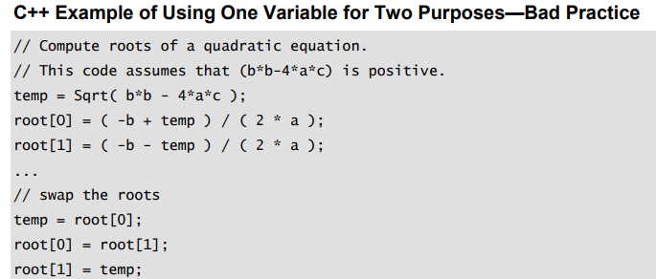
Using Each Variable for Exactly One Purpose
Question: What is the relationship between temp in the first few lines and temp in the last few?

Slide 11
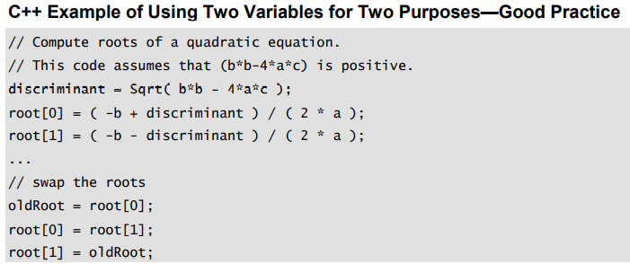
Using Each Variable for Exactly One Purpose
Creating unique variables for each purpose makes your code more readable.

Slide 12
Using Each Variable for Exactly One Purpose
Avoid variables with hidden meanings
Another way in which a variable can be used for more than one purpose is to have different values for the variable mean different things.
Make sure that all declared variables are used
Notes:
# Bad practice: Using a variable with hidden meanings
status = 1 # 1 means "active," 2 means "inactive"
# Better practice: Using explicit constants or enumerations
STATUS_ACTIVE = 1
STATUS_INACTIVE = 2
current_status = STATUS_ACTIVE # Now it's clear that 'current_status' represents an active state

Slide 13
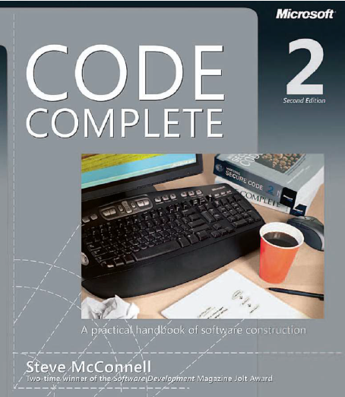
Reading
Code Complete: A Practical Handbook of Software Construction, 2nd Edition, Steve McConnell.
Chapter 10

Slide 14

Any questions? ​
Please feel free to raise your hands and ask.

